Slide 1
Predictive Maintenance of Industrial Machinery
CAPSTONE PROJECT
Presented By:
Sahil Chani-Guru Jambheshwar University of Science and Technology-Computer Science and Engineering

Slide 2
OUTLINE
Problem Statement
Proposed System/Solution
System Development Approach
Algorithm & Deployment
Result (Output Image)
Conclusion
Future Scope
References

Slide 3
Problem Statement
Unexpected machine failures in industrial settings lead to costly downtime and maintenance. This project aims to develop a predictive maintenance model using real-time sensor data to classify potential failures—such as tool wear, heat dissipation issues, or power failures—before they occur. By identifying patterns that precede failures, the model will enable proactive maintenance, reduce operational costs, and improve equipment reliability.
GitHub Link :-

Slide 4
Proposed Solution
The proposed system aims to predict potential machine failures in industrial environments using machine learning. By analyzing real-time sensor data, the solution accurately identifies fault types such as tool wear, heat dissipation issues, and power failures, enabling timely maintenance and minimizing downtime. The key components of the solution include:
Data Collection:
Utilized a publicly available dataset from Kaggle containing real-time operational sensor data from industrial machines.
Focused on identifying various failure modes to enable predictive classification and proactive maintenance planning.
Data Preprocessing:
Removed columns like UDI, Product ID, and Target to prevent data leakage during model training.
Standardized and cleaned feature variables to ensure consistent input for model training.
Machine Learning Algorithm:
Employed a Batched Tree Ensemble Classifier to predict machine failure types based on sensor readings.
The model was trained on a balanced and preprocessed dataset to ensure high predictive accuracy.
Deployment:
Designed the system to be compatible with real-time deployment and cloud integration for scalable industrial use.
Future-ready for integration with real-time sensor data and factory monitoring systems.
Evaluation:
Achieved a high accuracy of 98%, demonstrating strong performance in predicting multiple failure types.
The model exhibits excellent generalization and can be further refined with real-time and domain-specific data.

Slide 5
System Approach
The "System Approach" section outlines the strategy and resources used to develop the predictive maintenance model for industrial machinery. The system uses cloud resources and essential Python libraries to build, train, and evaluate the machine learning model for real-time failure prediction.
System Requirements:
IBM Cloud environment with 8 CPUs and 32 GB RAM for training and deployment.
High computational efficiency was maintained during preprocessing and training to handle sensor-rich datasets effectively.
Libraries Required to Build the Model:
Pandas – for reading, cleaning, and preprocessing the machine sensor dataset.
NumPy – for handling numerical calculations and data transformation.
Scikit-learn – used to implement the Batched Tree Ensemble Classifier and evaluate model performance.
Matplotlib / Seaborn – for visualizing sensor trends, feature importance, and classification outcomes.
Joblib / Pickle – for saving the trained model and supporting deployment into live systems.

Slide 6
Algorithm & Deployment
This section outlines the machine learning algorithm and deployment process used to predict failures in industrial machines using real-time sensor data.
Algorithm Selection:
Batched Tree Ensemble Classifier was selected for its ability to handle large-scale sensor data and provide robust multiclass classification.
The algorithm offers high accuracy and is effective in learning complex patterns from sensor inputs to distinguish between different failure types.
Data Input:
The model uses features collected from various sensors monitoring machine parameters like temperature, pressure, and vibration.
The target variable indicates specific failure modes such as tool wear, heat dissipation failure, or power failure.
Training Process:
The dataset was cleaned and standardized. Columns like UDI, Product ID, and Target were removed to prevent data leakage during training.
Training was performed on a rich dataset sourced from Kaggle, leveraging high-quality historical operational data.
The model achieved 98% accuracy, demonstrating strong predictive capability.
Prediction Process:
Once trained, the model processes real-time sensor inputs to classify the machine’s condition and predict the type of potential failure.
Designed for real-time deployment, the model can be integrated into industrial monitoring systems for proactive maintenance and failure prevention.

Slide 7
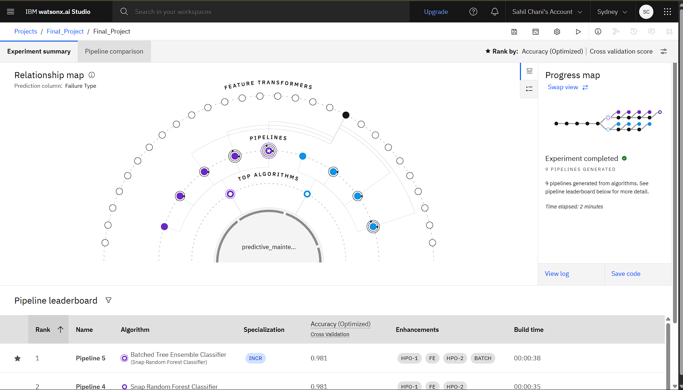
Result

Slide 8
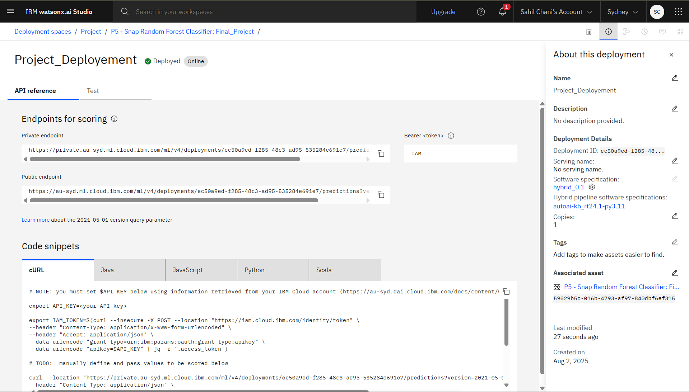
Result

Slide 9
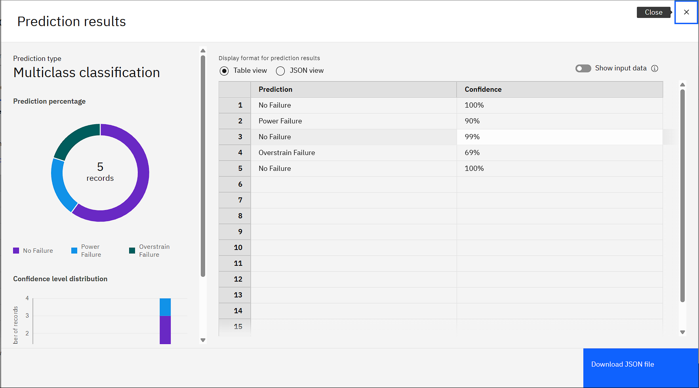
Result

Slide 10
Conclusion
The proposed machine learning-based predictive maintenance system demonstrates a highly effective approach for anticipating industrial machine failures using real-time sensor data. By leveraging the Batched Tree Ensemble Classifier, the model accurately classifies various failure types such as tool wear, heat dissipation, and power-related issues. The system was developed using publicly available data from Kaggle and shows strong potential for proactive maintenance in real-world industrial settings.
Effectiveness of the Solution:
The model achieved a high accuracy of 98%, indicating strong performance in identifying different machine failure types.
It validates the feasibility of automating failure prediction through machine learning, reducing downtime and improving maintenance efficiency.
Challenges Encountered:
Some features (e.g., UDI, Product ID, Target) had to be removed to prevent data leakage, slightly reducing directly usable information.
Real-time data variability and machine-specific calibration may affect future deployment accuracy.
Model performance might vary depending on sensor quality and the diversity of failure scenarios.
Importance of Accurate Predictions:
Accurate prediction of equipment failure is crucial to avoid unexpected breakdowns, improve operational continuity, and reduce maintenance costs. A reliable predictive model allows industries to shift from reactive to proactive maintenance, enhancing productivity and machine lifespan.

Slide 11
Future scope
Potential Improvements:
Real-time data collection from sensors installed on machines for live failure prediction and alerting.
Extend the model to work across different machine types and industrial domains with minimal retraining.
Link prediction outputs with maintenance management systems to auto-schedule inspections or repairs.
Deploy the model on edge devices for real-time, on-site inference without dependency on cloud connectivity.
Integrate explainability tools to help maintenance teams understand the reasons behind predictions.
Build intuitive dashboards to monitor machine health, visualize trends, and track failure risks over time.

Slide 12
References
Kaggle Dataset “ Predictive Maintenance of Industrial Machinery ." Retrieved from: https://www.kaggle.com/ (Used as the primary dataset for training and evaluating the classification model for machine failure prediction.)
IBM Cloud Platform Practical exposure gained during internship to develop and deploy machine learning models using IBM Cloud’s scalable infrastructure. (Used for model training, deployment readiness, and integration with cloud-based environments.)

Slide 13
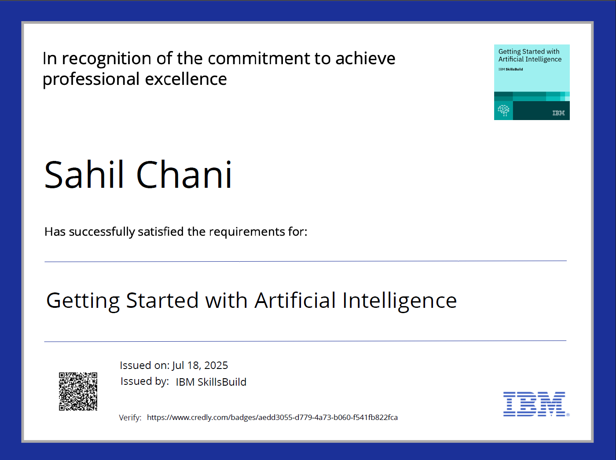
IBM Certifications

Slide 14
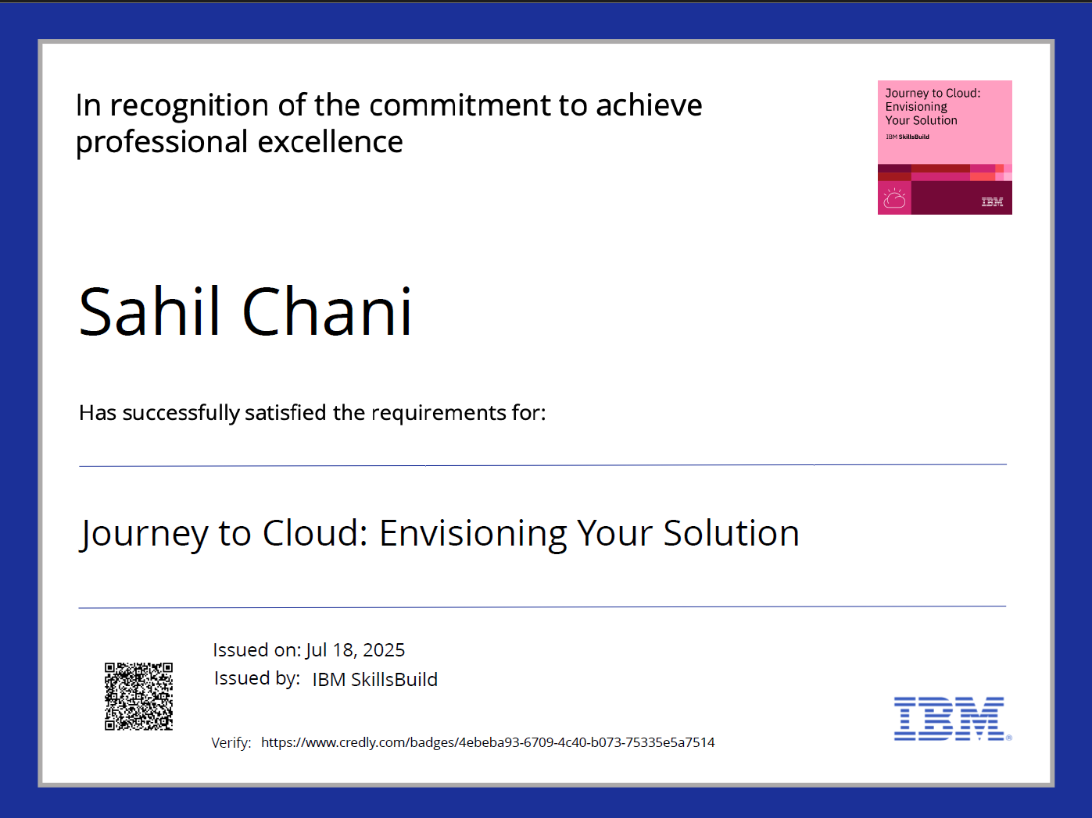
IBM Certifications

Slide 15
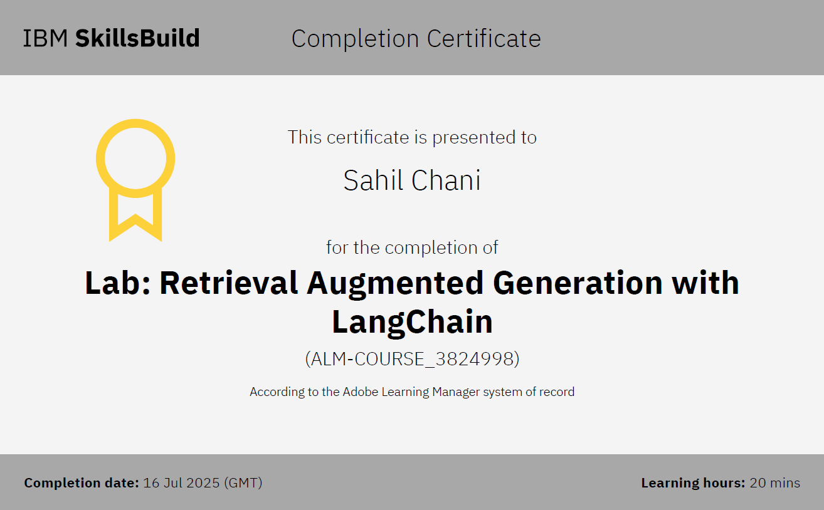
IBM Certifications

Slide 16
THANK YOU GitHub Link :-

